Slide 1
Spanning tree

Slide 2
definition
A spanning tree is a graph which contains all vertices with minimum number of edges.
It is a subgraph
It is a tree
Number of vertices - 1 = number of edges

Slide 3
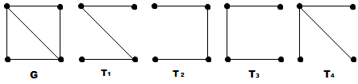
example:

Slide 4
Minimum spanning tree

Slide 5
definition
It is a spanning tree that has assigned weight and takes the minimum sum of weight.

Slide 6
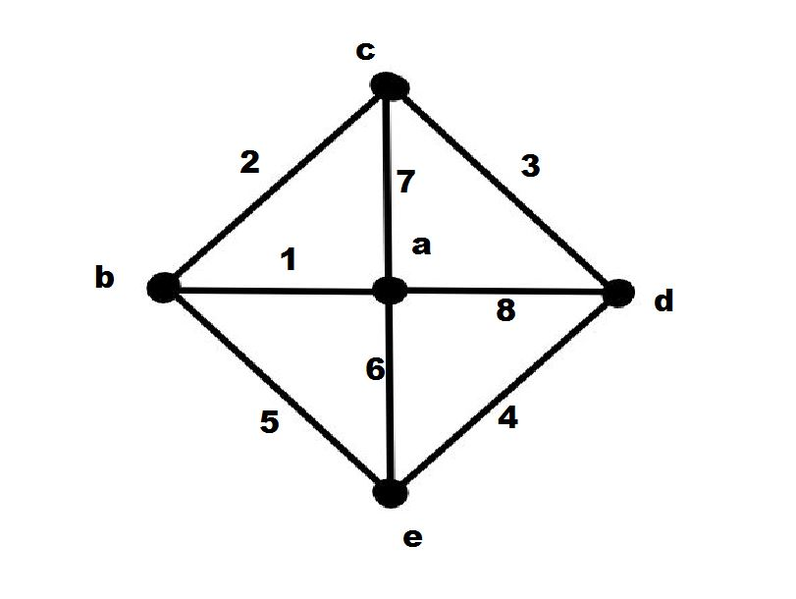
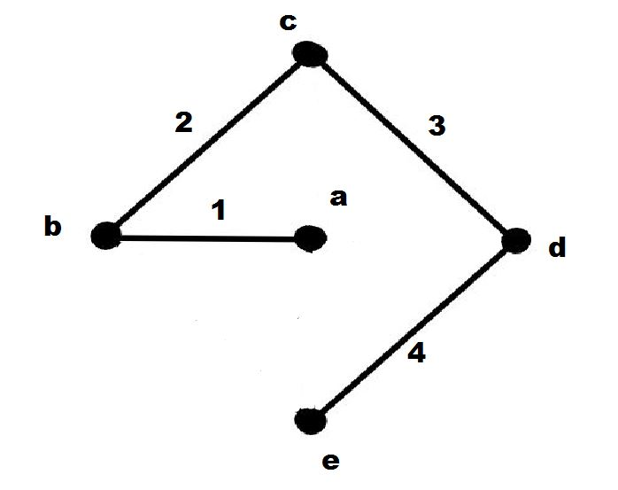
example

Slide 7
Kruskal’s algorithm

Slide 8
definition
Kruskal's algorithm is a greedy algorithm that finds a minimum spanning tree and the total weight of all the edges in the tree is less than or equal to every possible spanning tree.

Slide 9
algorithm
Step 1 − Arrange all the edges of the given graph G(V,E) in non-decreasing order as per their edge weight.
Step 2 − Choose the smallest weighted edge from the graph and check if it forms a cycle with the spanning tree formed so far.
Step 3 − If there is no cycle, include this edge to the spanning tree else discard it.
Step 4 − Repeat Step 2 and Step 3 until (V−1) number of edges are left in the spanning tree.

Slide 10
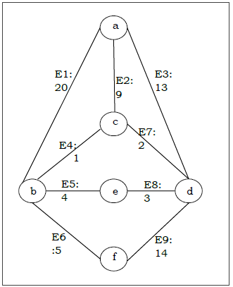
problem:

Slide 11
First we will construct a table in ascending order with respect to edge weight
Edge No. | Vertex Pair | Edge Weight
E4 | (b, c) | 1
E7 | (c, d) | 2
E8 | (d, e) | 3
E5 | (b, e) | 4
E6 | (b, f) | 5
E2 | (a, c) | 9
E3 | (a, d) | 13
E9 | (d, f) | 14
E1 | (a, b) | 20

Slide 12
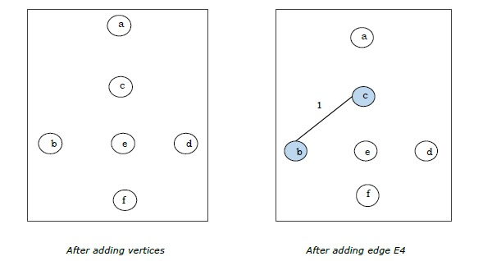

Slide 13
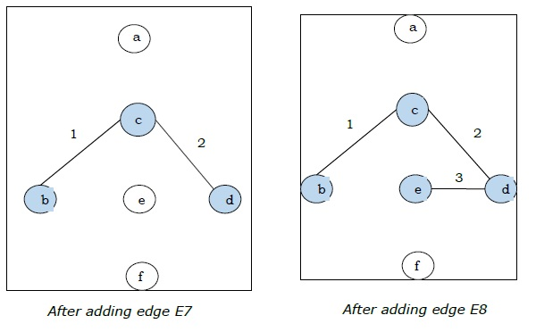

Slide 14
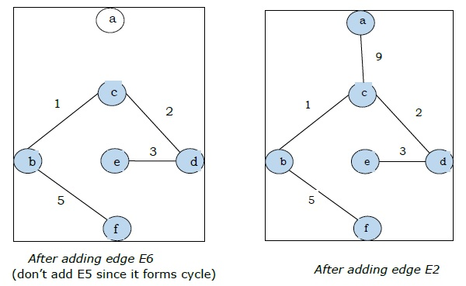
Since we got all the 5 edges in the last figure, we stop the algorithm and this is the minimal spanning tree and its total weight is (1+2+3+5+9)=20.

Slide 15
Prim’s algorithm

Slide 16
definition
It finds a tree of that graph which includes every vertex and the total weight of all the edges in the tree is less than or equal to every possible spanning tree. Prim’s algorithm is faster on dense graphs.

Slide 17
Algorithm
Initialize the minimal spanning tree with a single vertex, randomly chosen from the graph.
Repeat steps 3 and 4 until all the vertices are included in the tree.
Select an edge that connects the tree with a vertex not yet in the tree, so that the weight of the edge is minimal and inclusion of the edge does not form a cycle.
Add the selected edge and the vertex that it connects to the tree.

